Slide 1

Introducing Node.js
Lucas Jellema, 31st March 2016

Slide 2
Overview
Get used to it: JavaScript on the Server
First steps with Node.js and yes: hello world!
Some language essentials: functions (and closures)
Modules and npm
The Single Thread or: the quest for scalability
Handling HTTP requests
static file serving
serving rich client web applications [such as Oracle JET]
Implementing REST APIs and mBaaS (and iPaaS)
Making HTTP calls to external APIs and Services
Database interaction from Node.js

Slide 3
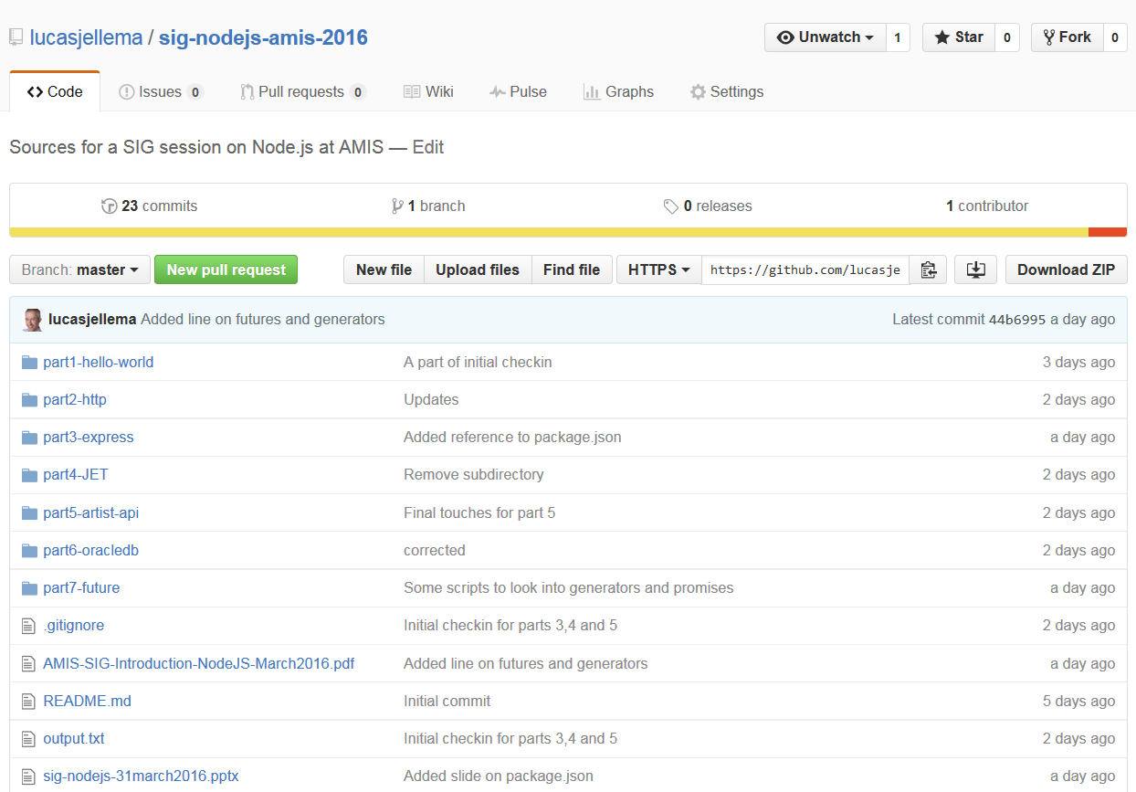
Supporting Resources on GitHub
https://github.com/lucasjellema/sig-nodejs-amis-2016

Slide 4
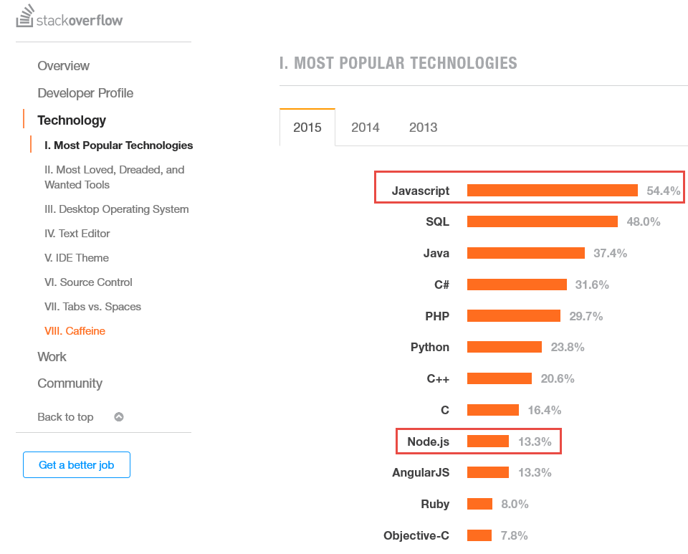
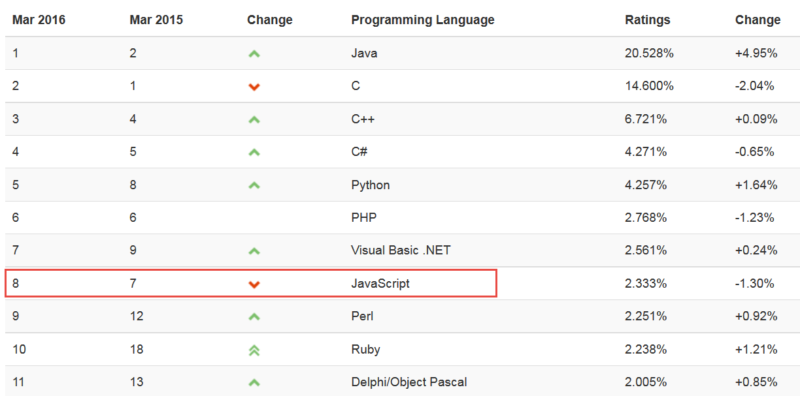
Popularity Ratings…
Notes:
http://stackoverflow.com/research/developer-survey-2015#tech

Slide 5
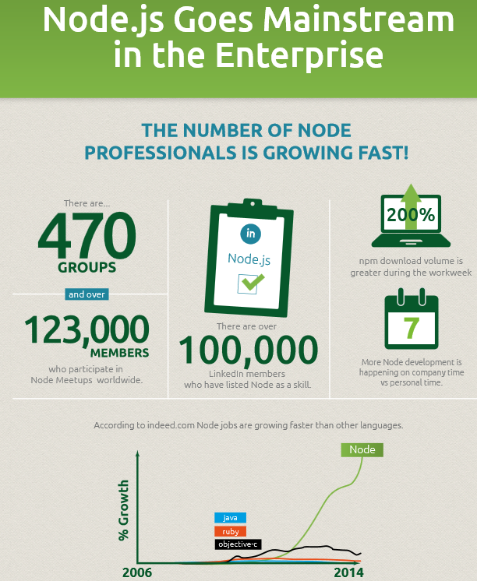
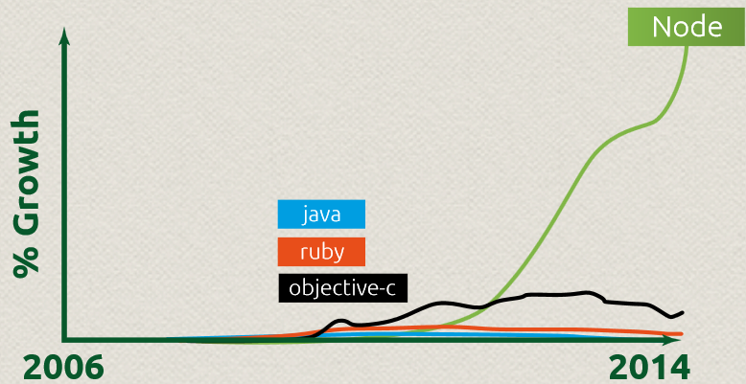

Slide 6
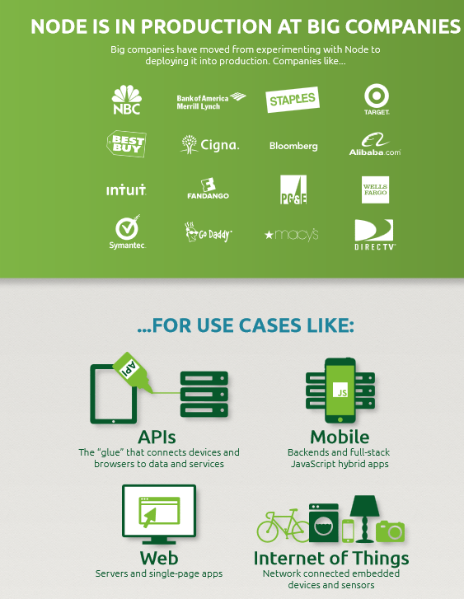
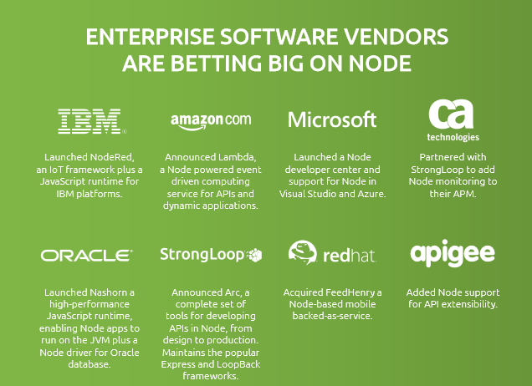

Slide 7
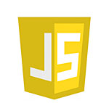

JavaScript in enterprise architecture
DB
Mobile Client
Web Tier
Static file serving
REST APIs
Business Tier
Integration
Orchestration/ BPM
Background Jobs
ERP
Browser
SaaS
External Service
External Service

Slide 8
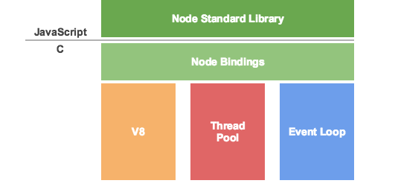

Node.js is like a JS-DK – JavaScript Virtual Machine
Custom Node.js app
Custom Node.js app
Custom Node.js app
machine code
Notes:
See: http://khan.io/2015/02/25/the-event-loop-and-non-blocking-io-in-node-js/

Slide 9
Brief History of Node.js
2009 – unveiled by Ryan Dahl, written on Linux, leveraging Google V8
2010
Initial release of express – the default web application server framework
2011
package manager npm introduced – to publish and share open-source Node.js libraries and simplify installation, updating and uninstallation of libraries
Native Windows implementation of Node.js released
2011-2015 Many Cloud Platforms supporting Node.js
Heroku, Joyent, Cloud Foundry, Nodester, NodeJitsu, Microsoft Azure, IBM BlueMix, Google AppEngine, AWS, …
2015
Oracle releases node-oracledb Database Driver for Node.js
Various forks brought back together: Node v4.0 including V8 with ES6 features
Open Source under Governance by the Node.js Foundation under Linux Foundation
Support for ARM processors
2016
Oracle Application Container Cloud with native support for Node.js applications
Current release: 5.9.1 (22nd March)
Notes:
https://github.com/oracle/node-oracledb

Slide 10



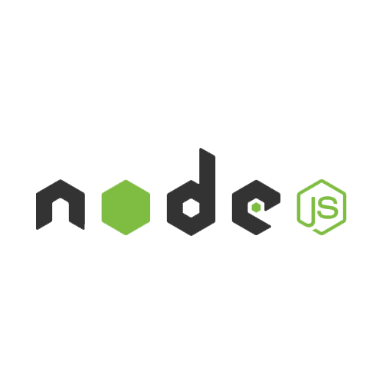


IoT CS
ACC
ICS
Compute
DBaaS
SOA CS
Storage
Compute
JCS
Storage
PCS
DBaaS
DCS
mediator-proxy
Compute
OSN
Sites CS
Storage
MCS
ACC
Compute
Storage

Slide 11
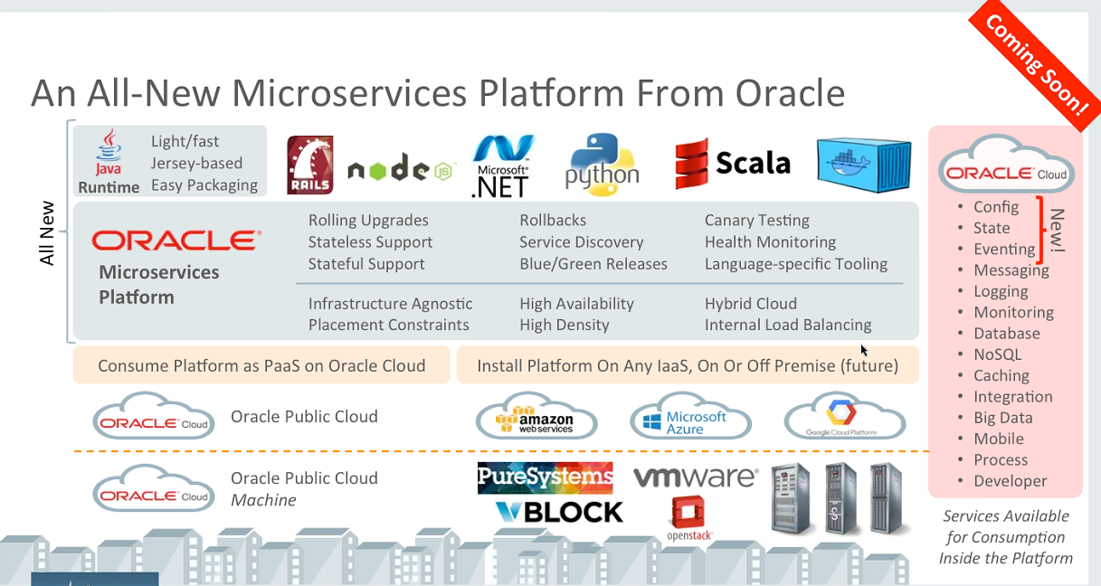
Node.js one of the viable platforms within new Oracle Micro Services platform

Slide 12
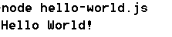
Hello World
// my first Node.js program
console.log("Hello World!");

Slide 13

Hello World – using a function
function greeting() {
console.log("Hello World!");
}
greeting();

Slide 14

Hello World – read commandline arguments
function greeting(greetedPerson) {
console.log("Hello "+ greetedPerson + "!");
}
// assume command line: node hello-world-3.js someName
var greetee = process.argv[2];
greeting(greetee);

Slide 15

Hello World – pass around a function reference
var g = function greeting(greetedPerson) {
console.log("Hello "+ greetedPerson + "!");
}
var greetee = process.argv[2];
g(greetee);

Slide 16

Hello World – have one function execute [a reference to ] another
var g = function greeting(greetedPerson) {
console.log("Hello "+ greetedPerson + "!");
}
var greetee = process.argv[2];
function reception( greetFunction, greetee) {
greetFunction(greetee); // execute the passed in function
}
reception(g, greetee);

Slide 17
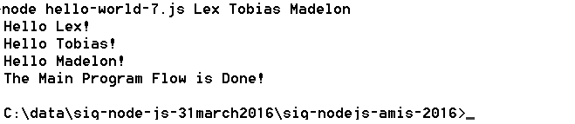
Hello World – callback functions and time outs – no state yet
// callback functions used with timeout
var g = function (greetedPerson) {
console.log("Hello "+ greetedPerson + "!");
}
var r = function ( greetFunction, greetee) {
greetFunction(greetee);
}
for (var i=2;i<process.argv.length;i++) {
setTimeout( r(g, process.argv[i]), i*1500);
}
console.log('The Main Program Flow is Done!');

Slide 18
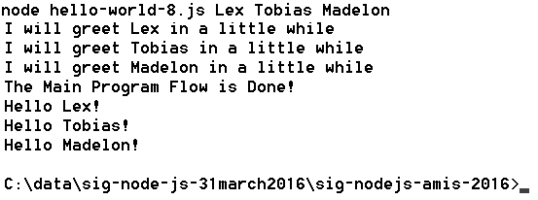
Hello World – closures with state executed on time out
var g = function (greetedPerson) {
console.log("Hello "+ greetedPerson + "!");
}
function getGreeter ( greetee, greetFunction) {
var toGreet = greetee;
console.log('I will greet '+ greetee + ' in a little while');
return function () { greetFunction(toGreet)}; // the closure }
for (var i=2;i<process.argv.length;i++) {
setTimeout( getGreeter( process.argv[i], g), i*1500);
}
console.log('The Main Program Flow is Done!');

Slide 19
Modules
Node programs can be organized in modules
A module is file that exports a scope that may contain (public) functions and shared objects
Modules are ‘imported’ through the require function
Add a line such as var localRef = require(‘moduleName’); in a file to get access at runtime to all the goodies from the module
Node ships with a set of core modules that can be required into any program – without additional installation or configuration; for example:
fs: file system operations
path: string transformations around file system operations
os: access to some operating systems details
util: utility functions, for example util.log to log messages to console with timestamp
http: for HTTP protocol based network operations

Slide 20
File manipulation from Node.js - using core module fs
//write a file with all command line arguments on separate lines
var fs = require('fs')
, util = require('util');
process.argv.slice(2).forEach(function (val) {
fs.appendFileSync("./output.txt", val + "\n");
});
util.log('The Main Program Flow is Done!');

Slide 21
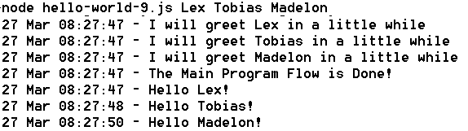
Hello World – using core module util
var util = require('util');
var g = function (greetedPerson) {
util.log(util.format('Hello %s!', greetedPerson));
}
function getGreeter ( greetee, greetFunction) {
var toGreet = greetee;
util.log( util.format('I will greet %s in a little while', toGreet));
return function () { greetFunction(toGreet)};
}
process.argv.slice(2).forEach(function (val, index, array) {
setTimeout( getGreeter(val, g), index*1500);
});
util.log('The Main Program Flow is Done!');

Slide 22
Packages
A package is a bundle of resources that supports development of a node application
Design time (test, code analyze, format, browserify, package, …)
Run time
A package can contain one or more modules that may or may not be intended to be ‘required’ into a node application
Packages are [downloaded and] added to the source folders of a node application
Package management can be tricky
An application can depend on multiple packages
Packages can depend on multiple [versions of] packages themselves
Gathering and keeping up to date all compatible versions of all required packages is potentially complex, time consuming and error prone
Enter: npm
and package.json – the closest thing to a pom-file

Slide 23
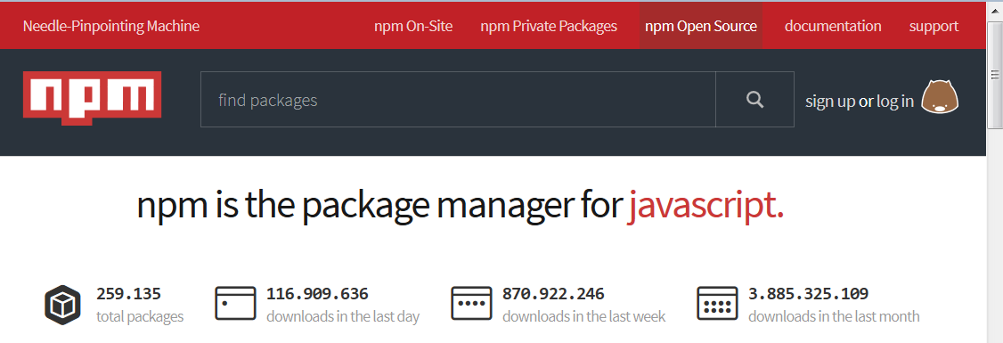
Reusing node modules
“So that's what npm is. It's a way to reuse code from other developers, and also a way to share your code with them, and it makes it easy to manage the different versions of code.”
www.npmjs.org

Slide 24
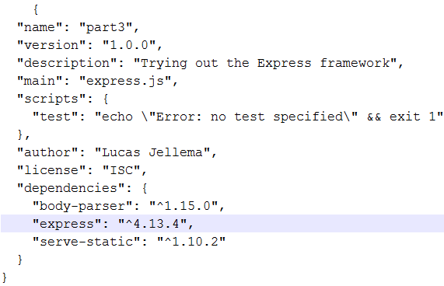
npm
Bring in a package to your current application
npm install <package name> The package is downloaded and installed in folder node_modules
Create a new application with a neat description
npm init This will create a package.json file that describes the [Node.js] application and its dependencies
Use
npm install <package name> --save To have dependencies on the package added to the package,json file
npm install To have all packages listed in package.json installed or updated into the node_modules folder

Slide 25
Node.js can handle incoming HTTP requests
Similar to a Java Servlet or PHP page, a Node.js application can contain logic to interpret and respond to an HTTP request
Web Tier
Static file serving
REST APIs
Browser
http request
Any other HTTP client

Slide 26
Core Modules for (inbound & outbound) networking: http, https, net, dgram
No separate installation required (included with core Node.js)
Handle incoming request and/or make outbound request
Handle URL (path, query parameters, post payload or Form encoding or file upload)
Handle headers, encoding, compression, …
Web Tier
http(s) request
http(s) request

Slide 27
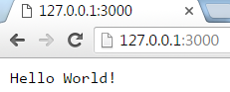
Simplest form of HTTP handling
// invoke from browser or using curl: curl http://127.0.0.1:3000
var http = require('http');
var server = http.createServer(function handleRequest(req, res) {
res.write('Hello World!');
res.end();
}).listen(3000);
console.log('server running on port 3000');
Web Tier
http(s) request

Slide 28
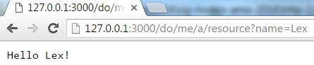
Interpret request and respond appropriately
// invoke: curl http://127.0.0.1:3000/do/me/a/resource?name=Lex
var http = require('http')
, url = require('url') ;
var server = http.createServer(function handleRequest(req, res) {
console.log('URL '+ req.url);
var queryObject = url.parse(req.url,true).query;
var name = queryObject.name;
console.log('path: '+url.parse(req.url).pathname);
console.log('queryObject: '+JSON.stringify(queryObject));
res.write('Hello '+ name + '!');
res.end();
}).listen(3000);
Web Tier
http(s) request

Slide 29
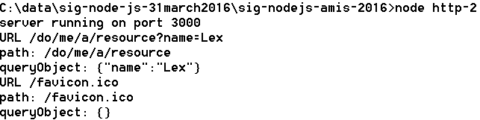
Interpret request and respond appropriately
// invoke: curl http://127.0.0.1:3000/do/me/a/resource?name=Lex
var http = require('http')
, url = require('url') ;
var server = http.createServer(function handleRequest(req, res) {
console.log('URL '+ req.url);
var queryObject = url.parse(req.url,true).query;
var name = queryObject.name;
console.log('path: '+url.parse(req.url).pathname);
console.log('queryObject: '+JSON.stringify(queryObject));
res.write('Hello '+ name + '!');
res.end();
}).listen(3000);
Web Tier
http(s) request

Slide 30
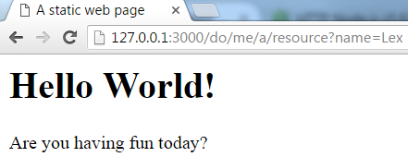
Static File Serving
// serve static file: /public/index.html
var http = require('http')
, fs= require('fs');
var server = http.createServer(function handleRequest(req, res) {
res.writeHead(200, { 'content-type': 'text/html' });
fs.createReadStream('./public/index.html').pipe(res);
}).listen(3000);
console.log('server running on port 3000');
Web Tier
http(s) request
Local file system
index.html

Slide 31
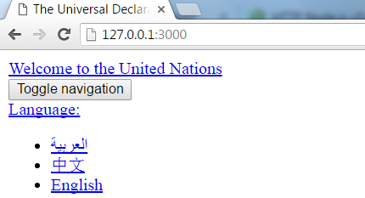
Remote Resource Serving – http in and http out
var http = require('http');
var options = {
host: 'www.un.org', path: '/en/universal-declaration-human-rights/' };
var server = http.createServer(function handleRequest(req, res) {
res.writeHead(200, { 'content-type': 'text/html' });
http.get(options, function handleRemoteResponse(resp) {
var body="";
resp.on("data", function(chunk) { //response returned in chunks
body = body+chunk;
});
resp.on("end", function() { //when response is complete, pass it on
res.end(body);
});
}).on('error', function(e) {
console.log("Got error: "+ e.message);
});
}).listen(3000);
Remote Website
http
request

Slide 32
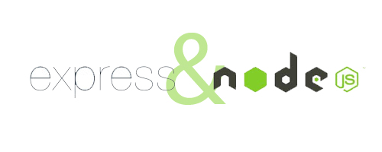
Express web application framework
Fast, unopinionated, minimalist web framework for Node.js
Framework on top of core Node.js top facilitate incoming HTTP requests
“Express provides a thin layer of fundamental web application features, without obscuring Node.js features that you know and love.”
Convenient for
Web Server for static files
API implementation (REST)
Any incoming HTTP request handling
Express is distributed as npm package
npm install express

Slide 33

Express - Simplest form of HTTP handling
// invoke from browser or using curl: curl http://127.0.0.1:3000
var express = require('express')
, http = require('http');
var app = express()
.use(function (req, res, next) {
res.end('Hello World!');
});
// Create HTTP server with Express app as the request listener
http.createServer(app)
.listen(3000);
Web Tier
http(s) request

Slide 34
Express – Even simpler form of HTTP handling (or at least simpler code)
// invoke from browser or using curl: curl http://127.0.0.1:3000
var express = require('express');
express().use(function (req, res, next) {
res.end('Hello World!');
}).listen(3000);
console.log('server running on port 3000');
Web Tier
http(s) request

Slide 35

Static File Serving
// static file server for all resources in public and below
// will server public/index.html when invoked at http://127.0.0.1:3000
var express = require('express'); //npm install express
express().use(express.static(__dirname + '/public'))
.listen(3000);
console.log('server running on port 3000');
Integration Tier
Local file system
http(s) request
index.html
image.jpg
some-pdf.pdf

Slide 36

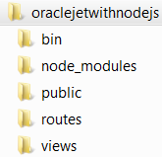
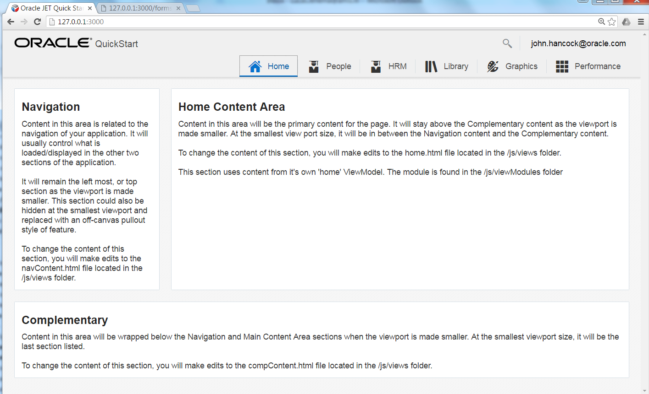
Oracle JET on Node.js
Oracle JET is a rich client web application
All the action is on the client
Role of Node.js: serve the JET application with all its required resources
All static HTML, CSS and JS files
app.js
Notes:
https://technology.amis.nl/2016/02/07/deploying-an-oracle-jet-application-to-application-container-cloud-and-running-on-node-js/

Slide 37
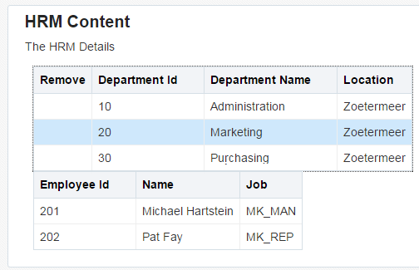
Oracle JET on Node.js
Oracle JET is a rich client web application
All the action is on the client
Role of Node.js: serve the JET application with all its required resources
All static HTML, CSS and JS files
Additionally: Node.js can provide back end APIs and proxy that JET application leverages
app.js
REST API
Notes:
https://technology.amis.nl/2016/02/07/deploying-an-oracle-jet-application-to-application-container-cloud-and-running-on-node-js/

Slide 38

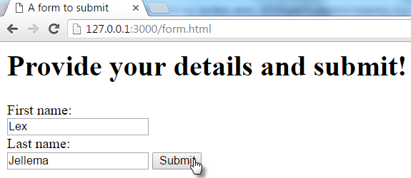
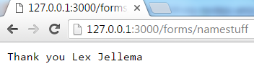
Handling Form Submit and other HTTP POST requests
// static file server for all resources in public and below
// AND handle forms submission to path /forms/...
var express = require('express'); //npm install express
var bodyParser = require('body-parser'); // npm install body-parser
var app = express()
.use(bodyParser.urlencoded({ extended: true}))
.post('/forms/*', function (req, res) { //process
console.log(JSON.stringify(req.body));
res.end('Thank you '+ req.body.firstname +' '+req.body.lastname);
})
.use(express.static(__dirname + '/public'))
.listen(3000);
Integration Tier
Local file system
POST request

Slide 39
Handling REST GET requests
var express = require('express'), fs = require('fs');
var departments= JSON.parse(fs.readFileSync('departments.json', 'utf8'));
var app = express()
.get('/departments/:departmentId', function (req, res) {
var department = getDepartment(req.params['departmentId']);
console.log(JSON.stringify(department));
res.send( department);
})
.get('/departments', function (req, res) {
res.send( departments);
})
.use(express.static(__dirname + '/public'))
.listen(3000);
function getDepartment(depIdentifier) {
for (var i=0; i< departments.length; i++) {
if (departments[i].DEPARTMENT_ID == deptIdentifier) {
return departments[i];
}//if
}//for
}// getDepartment
Integration Tier
Local file system
GET request
departments .json

Slide 40
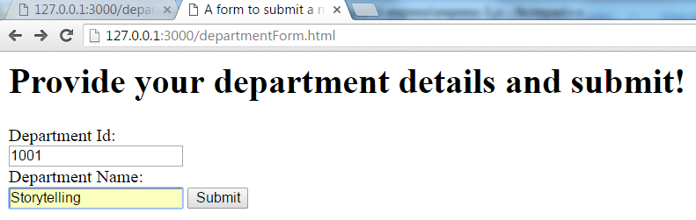
Handling REST GET & Form POST requests
var express = require('express'),bodyParser = require('body-parser') , fs = require('fs');
var app = express()
.use(bodyParser.urlencoded({ extended: true}))
.post('/forms/department', function (req, res) { //process
console.log(JSON.stringify(req.body));
departments.push( {"DEPARTMENT_ID":req.body.departmentId ,"DEPARTMENT_NAME":req.body.departmentName}); res.end('Thank you for the new department '+ req.body.departmentId+" "+req.body.departmentName);
}) .get('/departments/:departmentId', function (req, res) {
…
.listen(3000);
Integration Tier
Local file system
GET request
Form Submit
departments .json

Slide 41
Serve Department details – retrieved from external REST API
var express = require('express'),bodyParser = require('body-parser') , fs = require('fs'), https = require('https');
var app = express()
.get('/departmentdetails/:departmentId', function (req, res) { var departmentId = req.params['departmentId'];
var department = getDepartment(departmentId);
// get employee details for department from remote API
https.get({ host: 'data-api-oraclecloud.com', port: 443,
path: '/departments/'+departmentId, method: 'GET'
}, function handleRemoteResponse(resp) {
var body="";
resp.on("data", function(chunk) {body += chunk; });
resp.on("end", function() {
department.employees = JSON.parse(body);
res.send(department); });
});
})
.listen(3000);
REST API
Integration Tier
Local file system
GET request
departments .json

Slide 42

And now for a real USP

Slide 43
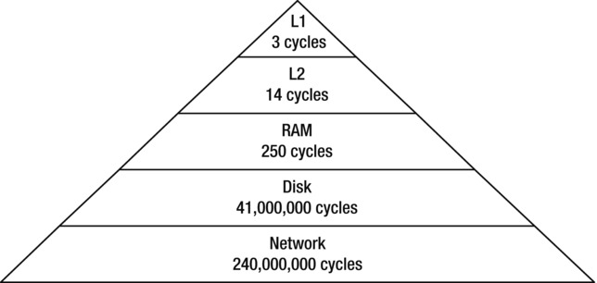
Access speed for data retrieved from various sources
Source: Beginning Node.js - by Basarat Ali Syed Apress, released: December 2014

Slide 44
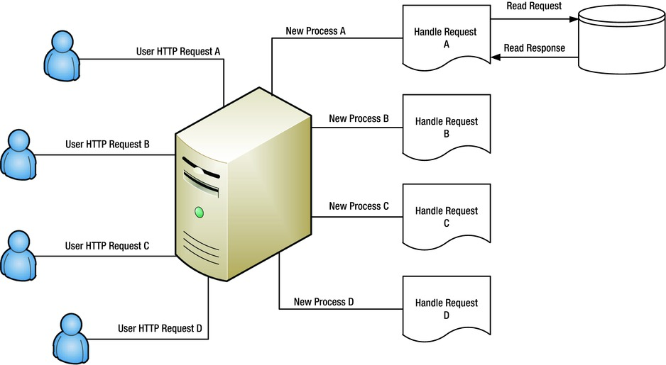
Threads in web application handling HTTP-requests
Source: Beginning Node.js - by Basarat Ali Syed Apress, released: December 2014

Slide 45
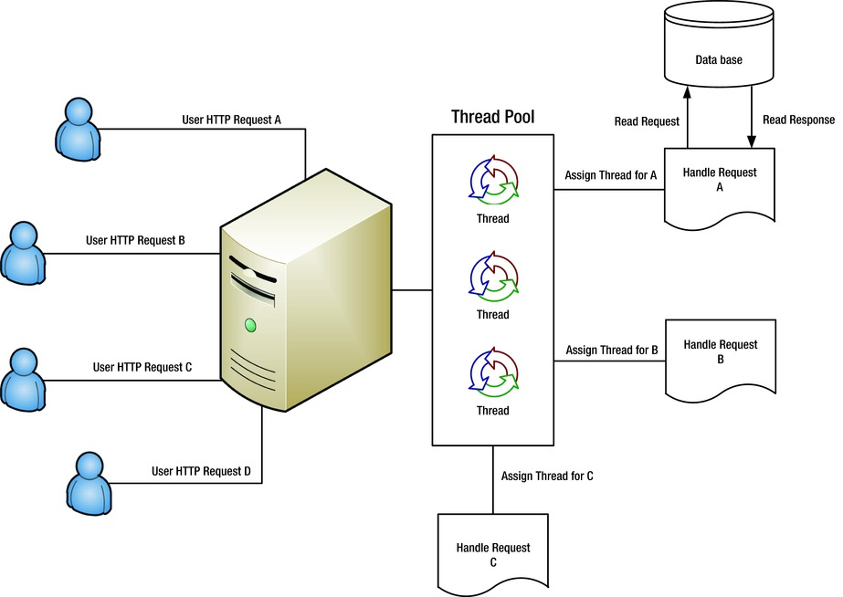
Ready-to-run Threads in web application handling HTTP-requests
Source: Beginning Node.js - by Basarat Ali Syed Apress, released: December 2014

Slide 46

Warehouse
shopping area
cash registers
waiting area
desk to collect
large pieces
Only a single desk to handle all customers who want to have stuff from the warehouse brought to them – compare with over a dozen cash registers
Exit

Slide 47
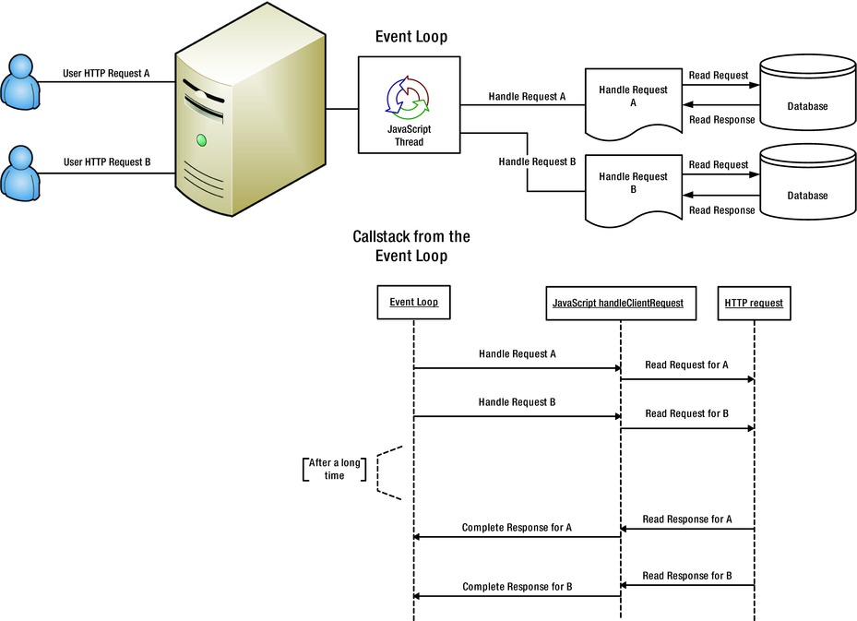
Single Thread model in Node.js

Slide 48
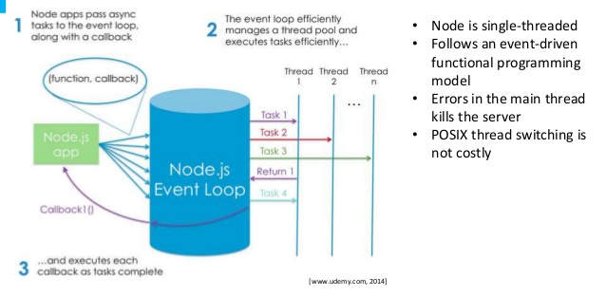
Single Thread
No synchronous calls or blocking waits are done on the thread
intensive work too is pushed to another process
After the question is asked, the thread moves
When a response arrives – as an asynchronous event – the callback function is given the opportuniy to act on it
Again, as quickly as possible, not tying up shared resources!

Slide 49
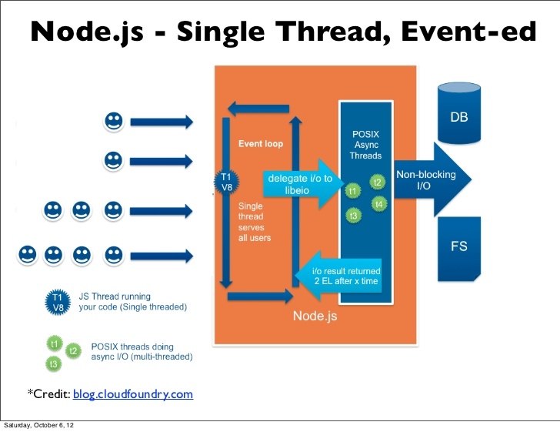

Slide 50
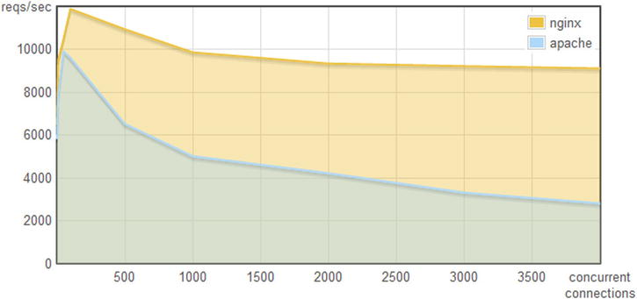

The single thread way: Nginx

Slide 51
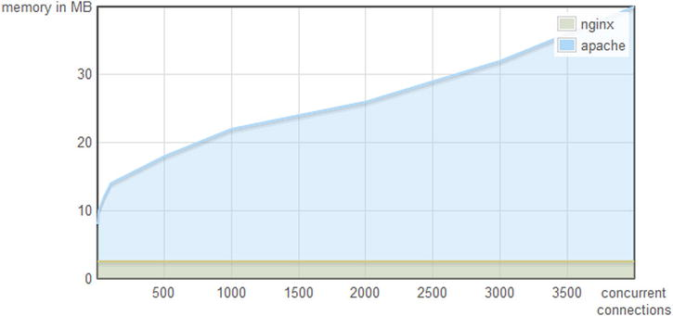
The single thread way: Nginx

Slide 52
Asynchronously assembling the HTTP response
Receive HTTP request
Possibly leverage cookie to re-establish state/context
Set work in motion to collect data (remote API call, DB call) and register callback – with original request scope
Stop processing, vanish, release resources
When callback is invoked, use response to construct the response
Complete and send the response
Callback == Closure
(function to execute with context to execute in)

Slide 53

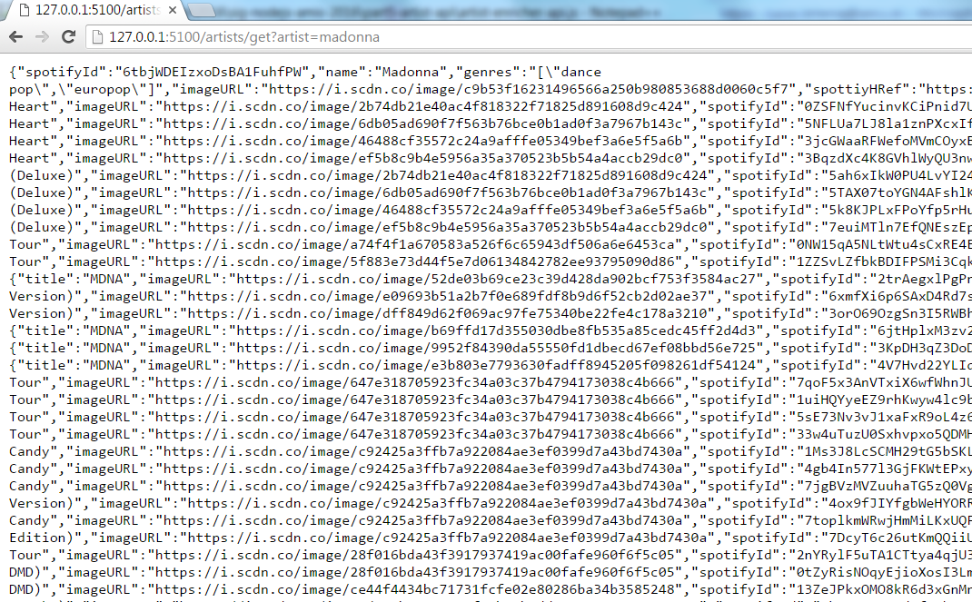

Artist API
Provide rich JSON message for an artist
External APIs invoked: Spotify and Echonest
External calls are made in parallel
Waiting is done in parallel
Constructing the response is done when both responses are in
GET request
for some artist
Integration Tier

Slide 54
async
The node module async is a utility module which provides straight-forward, powerful functions for working with asynchronous JavaScript.
Available for server side Node.js and for use in the browser client
Program easily with asynchronous interactions
Coordinate parallel or sequential calls and deal with errors
Example operations:
Map
Reduce
Filter
Waterfall
Parallel
ForEachOf
Series
Notes:
https://github.com/caolan/async

Slide 55
async – execute in parallel
var async = require(‘async')
, fs = require(‘fs'); var obj = {dev: "/dev.json", test: "/test.json", prod: "/prod.json"};
var configs = {};
async.forEachOf(obj, function (value, key, callback) {
fs.readFile(__dirname + value, "utf8", function (err, data) {
if (err) return callback(err);
try {
configs[key] = JSON.parse(data);
} catch (e) {
return callback(e);
}
callback();
});
}, function (err) { // when all parallel actions are done – do something
if (err) { console.error(err.message); return;}
// configs is now a map of JSON data
doSomethingWith(configs);
})
For each property in the object…
… execute this function
Asynchronously read the file
.. and when done, call this function
Notify forEachOf of the completion of this branch
When all parallel branches under forEachOf are done, do this function

Slide 56
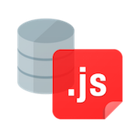
node-oracledb database driver
The node-oracledb driver connects to Oracle Database for fast and functional applications. It is an open source project with Apache 2.0 license.
It is maintained as an NPM package by Oracle and is under active development.
https://github.com/oracle/node-oracledb or npm install node-oracledb
Note: the Oracle Application Container Cloud preloads this driver to any instance of a Node.js container – ready to connect to DBaaS or on premises database
Support for SQL and PL/SQL, Transaction Management, CLOBs and BLOBs, Ref Cursors, Types and Collections, authentication, …
Leveraging OCI Oracle (Fat) Client Libraries
Notes:
https://github.com/oracle/node-oracledb
http://www.oracle.com/technetwork/database/database-technologies/scripting-languages/node_js/index.html
https://technology.amis.nl/2016/02/06/linking-application-container-cloud-to-dbaas-expose-rest-api-from-node-js-application-leveraging-node-oracle-database-driver/
https://oraclejetsample-lucasjellema.apaas.em2.oraclecloud.com/?root=hrm
https://data-api-lucasjellema.apaas.em2.oraclecloud.com/departments
https://artist-enricher-api-lucasjellema.apaas.em2.oraclecloud.com/artists/get?artist=meat+loaf

Slide 57
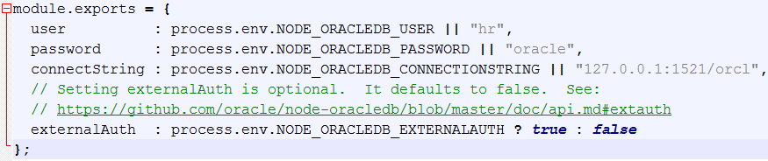
Connect to Oracle Database from node application …
var oracledb = require('oracledb');
var dbConfig = require('./dbconfig.js');
oracledb.getConnection(
{
user : dbConfig.user,
password : dbConfig.password,
connectString : dbConfig.connectString
},
function(err, connection)
{
if (err) {
console.error(err.message);
return;
}
connection.execute(
...
Integration Tier

Slide 58
… and perform SQL or PL/SQL
...
connection.execute(
"SELECT department_id, department_name " +
"FROM departments " +
"WHERE department_id = :did",
[180],
function(err, result)
{
if (err) {
console.error(err.message);
doRelease(connection);
return;
}
console.log(result.metaData);
console.log(result.rows);
doRelease(connection);
});
});
function doRelease(connection)
{ connection.release( function(err) {…});}
Integration Tier

Slide 59


Oracle Application Container Cloud for Node.js with DB driver
Application Container Cloud
Docker
Node.js Container
Service Binding
REST clients
data-api
REST API
oracledb
DB driver
DBaaS
demos
PDB1
HR
MyJCSDB

Slide 60
Next steps and beyond
API Development
Explore npm packages – 10Ks of them
For SOAP, XML, IMDB, Dictionary, Geography, Text-to-Speech, Loopback mBaaS …
Advanced topics: Web Sockets , security, scaling, H/A, state in a stateless world, queuing and scheduling ‘background jobs’
Creating your own modules and NPM packages
Contribute to existing packages
Promises – for an escape from callback hell
IDEs – Visual Studio Code, WebStorm, NetBeans
Debugging
Testing
Deployment
Rethink mBaaS & iPaaS
Notes:
On websockets: https://devcenter.heroku.com/articles/node-websockets

